Slide 1
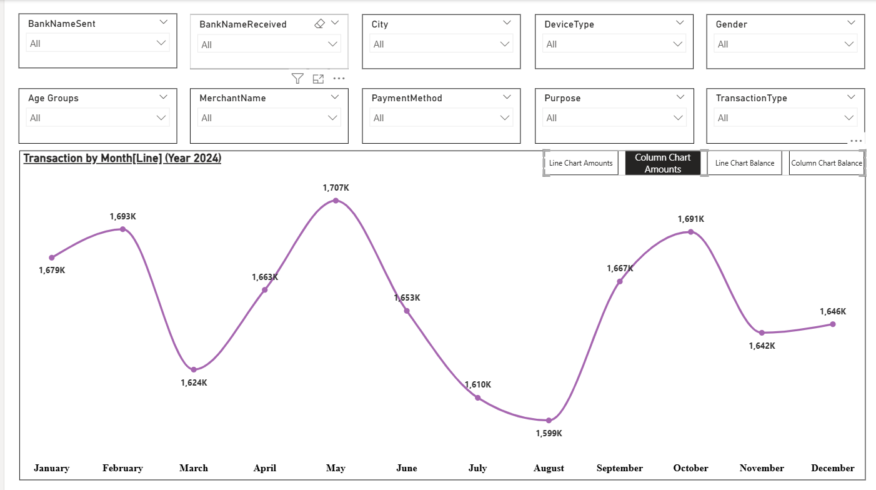
POWER BI DASHBOARD
UPI Transaction Analysis
20,000 transactions across 4 cities and 4 banks, January to December 2024
Notes:
This deck walks through the UPI Transaction Analysis dashboard: the data behind it, the filters, the monthly view and the city and currency table.

Slide 2
The dataset at a glance
20,000
19.9M
994
80%
Transactions
Total amount (all currencies)
Average amount
Success rate (16,000)
Who
City, Gender, CustomerAge, account numbers
How
DeviceType, PaymentMethod, PaymentMode, TransactionType
What
Amount, RemainingBalance, Status, Merchant, Purpose, banks, Currency
Notes:
The data has 20,000 UPI transactions for 2024, with 20 fields grouped here by who made the payment, how it was made and what it was for. Amounts are in four currencies, so the total mixes them.

Slide 3
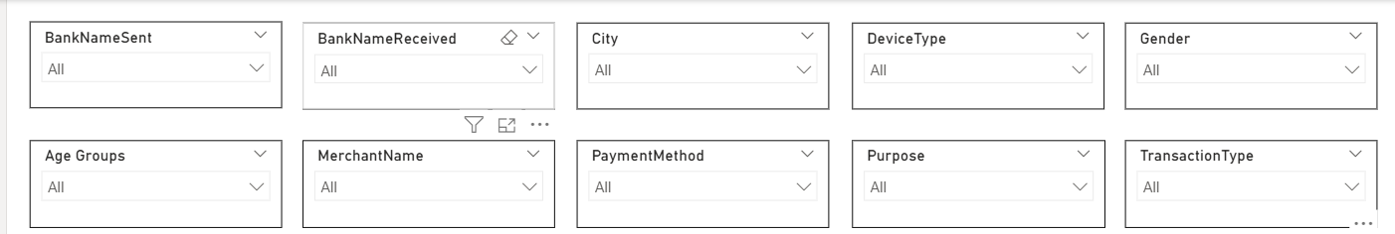
Ten slicers filter every view
Bank Sent
Bank Received
City
Device Type
Gender
Age Group
Merchant
Payment Method
Purpose
Transaction Type
Notes:
Ten slicers sit above the visuals. Any combination narrows the monthly chart and the table together.

Slide 4
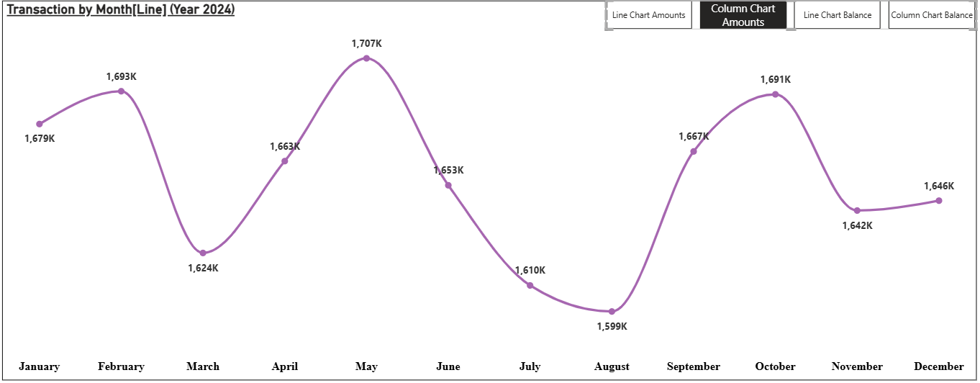
Transactions by month, 2024
Peak month
May reaches the highest total at 1,707K
Lowest month
August dips to 1,599K
Other highs
February and October both pass 1,690K
Four buttons switch between line and column charts of amounts and balances
Notes:
The smoothed line shows the total amount for each month. The buttons at the top right of the chart swap between line and column views and between amounts and remaining balance.

Slide 5
Volume stays steady all year
Peak May 1,707K Low Aug 1,599K Gap between them: about 7%
1679
1693
1624
1663
1707
1653
1667
1691
1642
1646
1610
1599
Jan
Feb
Mar
Apr
May
Jun
Jul
Aug
Sep
Oct
Nov
Dec
Notes:
Plotting the monthly totals from zero shows how flat the year is: the best month is only about 7% above the weakest. Values in thousands.

Slide 6
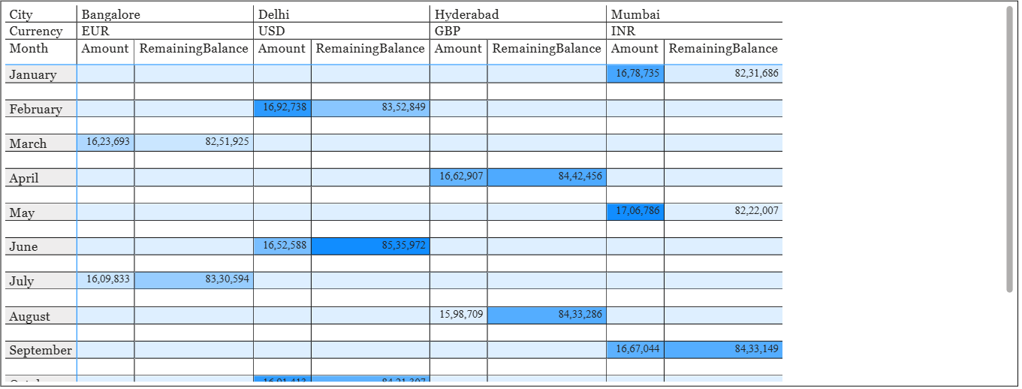
City, currency and month table
One currency per city
Bangalore EUR, Delhi USD, Hyderabad GBP, Mumbai INR
One city per month
Mumbai, Delhi, Bangalore and Hyderabad take turns each month
Amount and RemainingBalance for each city and month, shaded darker for larger values
Highlights
May (Mumbai) has the top amount, 1.71M; June (Delhi) the top balance, 8.54M
Notes:
A matrix of city by currency by month. Darker blue cells mark larger amounts and balances.

Slide 7
Key takeaways
Monthly totals stay between 1,599K and 1,707K
1
80% of the 20,000 transactions succeed
2
Ten slicers cut the data by bank, city, device, age and more
3
City, currency and month table shows amounts and balances together
Thank you
4
Notes:
Close with the four takeaways and invite questions.

